Slide 1


Brand Guide
Zero-Trust enforcement that compiles into your .NET apps.
Supersedes the v1.0 text reference of June 2026. Every colour and type
value here was read out of the live stylesheet, and four of v1.0’s did not match.
Version 2.0 · 2026 · B5 SECURE LLC · CONFIDENTIAL

Slide 2

HOW TO USE THIS GUIDE
Three rules, then the system.
This guide supersedes B5-Secure-Brand-Guide-Reference.md v1.0. Where an existing asset disagrees with it, the guide wins and the asset gets corrected.
1 · Ground truth beats memory
2 · Web and produced differ
3 · Every claim carries a source
Every hex value and type face here was measured from uploads/b5/b5.css on the deployed site. v1.0 was written before the stylesheet settled, and four of its colours are now wrong.
The live site is set in Sora, Inter and JetBrains Mono. Decks, PDFs and one-pagers are set in Arial and Courier New, because the reader may not have the web faces installed.
B5 is pre-revenue. Modelled figures are labelled modelled. Statistics carry a named, dated publisher. An unsourced number is a defect, not a rounding choice.
What changed, and what is still unresolved, is recorded in full on the Drift register at the back of this guide.
B5 Secure™ Brand Guide · v2.1 · 2026 · B5 SECURE LLC · Published for press & partner use
2

Slide 3

01
Positioning
What B5 Secure is, the contract it enforces, and the one word that changed.
B5 Secure™ Brand Guide · v2.1 · 2026 · B5 SECURE LLC · Published for press & partner use
3

Slide 4
BRAND AT A GLANCE
What B5 Secure™ is — and how we say it.
The one-liner
B5 Secure™ is the enforcement layer that ties identity to data — fail-closed authorization, down to the individual data element, for human users and AI agents alike.
The contract
The category
Authenticate (who) → authorize the data element (what, which) → gate the data on the decision. The same contract for users and agents.
Authorization, not identity. Identity proves who; it does not decide what. Absence of a permit is a denial.
The hero line
The relationship to A8 Core™
Zero-Trust enforcement that compiles into your .NET apps. Do not trademark “Never Trust” or “ADA” — both are descriptive.
B5 may serve as the security component of A8 Core™ under an inter-company arrangement. Separate brand, separate IP, separate entity.
B5 Secure™ Brand Guide · v2.1 · 2026 · B5 SECURE LLC · Published for press & partner use
4

Slide 5
THE PIPELINE
Five stages. The decision is the fifth.
Signing is one stage, not the product. The product is the decision at B5 — and the data is gated on it.
B1
B2
B3
B4
B5
Screen
Authenticate
Gate
Verify
Authorize
Reject what never should have arrived.
Signed request. HMAC → RFC 9421 → ML-DSA.
IP firewall and MFA at the perimeter.
Verify or suspend the session.
The data-element decision. Fail-closed.
“Identity proves who. It doesn’t decide what. B5 authorizes the data element — fail-closed, for users and agents.”
Use › as the stage connector in diagrams. Accent the B5 stage in gold; the other four stay neutral.
B5 Secure™ Brand Guide · v2.1 · 2026 · B5 SECURE LLC · Published for press & partner use
5

Slide 6
THE FOUR PILLARS
What the product actually does.
Every deck, page and one-pager should be traceable to one of these four. If it is not, it is probably a feature, not a pillar.
1
Data-element authorization (ADA)
2
Signed requests
Decides every operation against the exact data element requested, not the record it happens to live in. Fail-closed: absence of a permit is a denial.
HMAC today, RFC 9421 next, post-quantum ML-DSA after. Integrity and anti-replay, end to end. HMAC authenticates — TLS encrypts.
3
Decision-gated detokenization
4
Agentic AND-gate
Sensitive fields stay tokenized. Plaintext is revealed only on a grant, scoped to the specific fields the grant covers.
An agent acts only where the agent’s authority and the user’s authority both allow it, per data element, fail-closed.
B5 Secure™ Brand Guide · v2.1 · 2026 · B5 SECURE LLC · Published for press & partner use
6

Slide 7
THE WORD THAT CHANGED
Data element, not record.
The architecture was redesigned in July 2026 from record-level to data-element-level authorization. This is the single most important language change in the brand, and it is not yet complete on the site.
RETIRED WORDING
CURRENT WORDING
“fail-closed, per record”
“authorizes every data element”
Describes a coarser product than the one specified. Do not use in new copy.
Live and approved on 133 A8 Core™ pages. This is the phrasing to reuse.
MEASURED STATE — THE SWEEP IS NOT DONE
b5secure.com
57 instances of “per-record” in published page copy, plus the sitewide ribbon.
a8core.com
20 instances on 16 pages, 6 of them legal, against 133 pages saying “data element”.
B5 Secure™ Brand Guide · v2.1 · 2026 · B5 SECURE LLC · Published for press & partner use
7

Slide 8
02
Identity
The name, the entity, the mark — and the separation that protects all three.
B5 Secure™ Brand Guide · v2.1 · 2026 · B5 SECURE LLC · Published for press & partner use
8

Slide 9
NAME, ENTITY AND MARKS
Get the name right first.
The product name, the operating entity and the trademark position are three different things and are not interchangeable in copy.
Product name
B5 Secure™ — two words, capital B, capital S, ™ on first prominent use per asset
Never written
B5secure · B5-Secure · b5 secure · BS Secure · “B5” alone in running copy
Operating entity
B5 SECURE LLC — California registration #202114811376
Registered address
PO Box 1410, Menlo Park, CA 94026-1410
Trademark plan
Register the word mark “B5 SECURE” in Classes 9 and 42
Do not trademark
“Never Trust” and “ADA” — descriptive terms, not brand assets
Copyright line
Use verbatim; it appears in full on the back page of this guide
“ADA” expands to Authorization Decision Architecture on first use in any external asset. It is a product term, not an initialism the reader already knows.
B5 Secure™ Brand Guide · v2.1 · 2026 · B5 SECURE LLC · Published for press & partner use
9

Slide 10
VENTURE SEPARATION
The guardrail that protects the asset.
B5 Secure is its own venture. Blurring it into A8 Core, or into anything contested, is the one brand error with legal consequences.
HOLD THESE SEPARATE
DO NOT DO THESE
B5’s brand, IP and entity stay distinct from A8 Core™ and Financial Infrastructure, Inc.
B5 may be described as the security component of A8 Core™ — under an inter-company arrangement, named as such.
Keep entirely separate from TrustModel.ai.
Keep entirely separate from any contested ISCP IP.
B5 assets carry the B5 copyright line, never A8’s.
Import A8 Core™ GTM, scale or customer claims into B5 copy.
Present B5 as a feature of A8 Core™ rather than a separate venture.
Use one combined logo lockup for the two brands.
Cite A8’s account-catalog figures as B5 evidence.
Describe B5 as “HMAC” — signing is one stage of five.
B5 Secure™ Brand Guide · v2.1 · 2026 · B5 SECURE LLC · Published for press & partner use
10

Slide 11
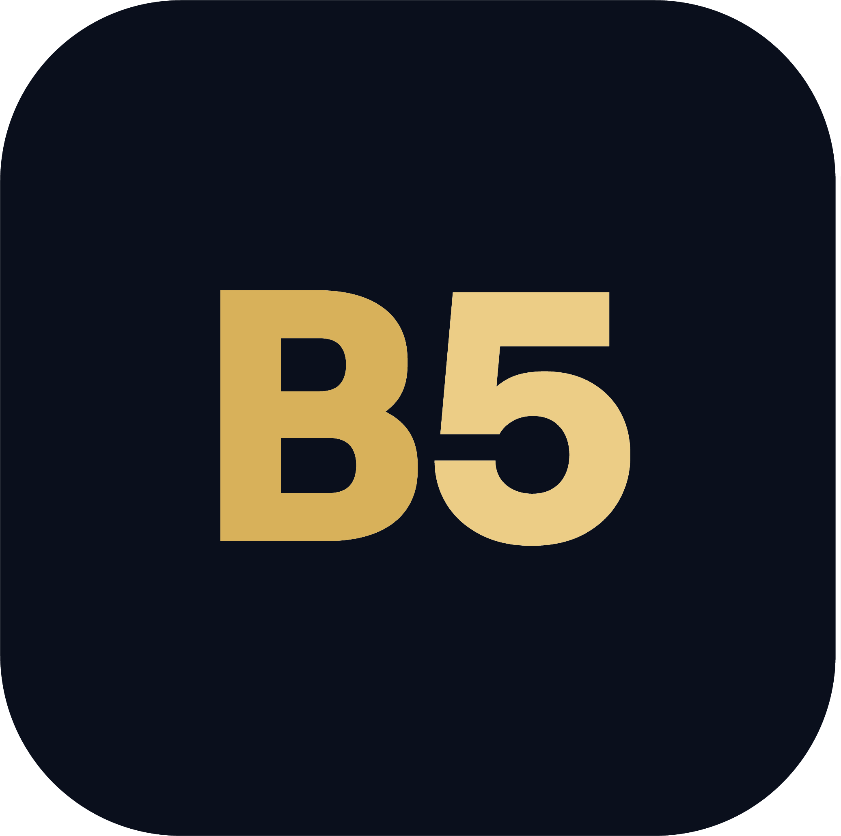
THE LOGO SYSTEM
Gold mark on dark is primary.
The mark is a rounded plate carrying the B5 glyphs. The lockup is the mark plus the B5 Secure wordmark.
Primary
Gold mark on dark ground
Reversed
White mark on dark, or over photography
Clear space
At least the height of the “B” on all four sides
Minimum size
24px digital, 0.35in in print
Primary — gold mark, reverse wordmark, on ink ground
Wordmark
Artwork, not live text — never re-typeset it
OPEN — THE LOCKUP FILES ARE BLUE, NOT GOLD
b5-logo.svg / b5-lockup-horizontal.svg #2f6bd6 #7db4ff #e8eefb -- blue
b5-mark-gold.svg #d8b15a #eccd86 -- gold, as specified
B5 Secure™ Brand Guide · v2.1 · 2026 · B5 SECURE LLC · Published for press & partner use
11

Slide 12
LOGO — DON’T
Protect the mark.
Six failure modes. Each one is a rejection, not a preference.
✗
Don’t recolour the mark
✗
Don’t distort or rotate
Gold or white. Nothing else, ever.
Scale proportionally and keep it level.
✗
Don’t add shadows or outlines
✗
Don’t place on a light ground
The mark carries no effects.
The plate is dark by design.
✗
Don’t re-typeset the wordmark
✗
Don’t crowd it
It is artwork, not live text.
Clear space is the height of the “B”.
B5 Secure™ Brand Guide · v2.1 · 2026 · B5 SECURE LLC · Published for press & partner use
12

Slide 13
03
Colour
An ink ground, gold for the decision, blue for the user, mint for allowed.
B5 Secure™ Brand Guide · v2.1 · 2026 · B5 SECURE LLC · Published for press & partner use
13

Slide 14
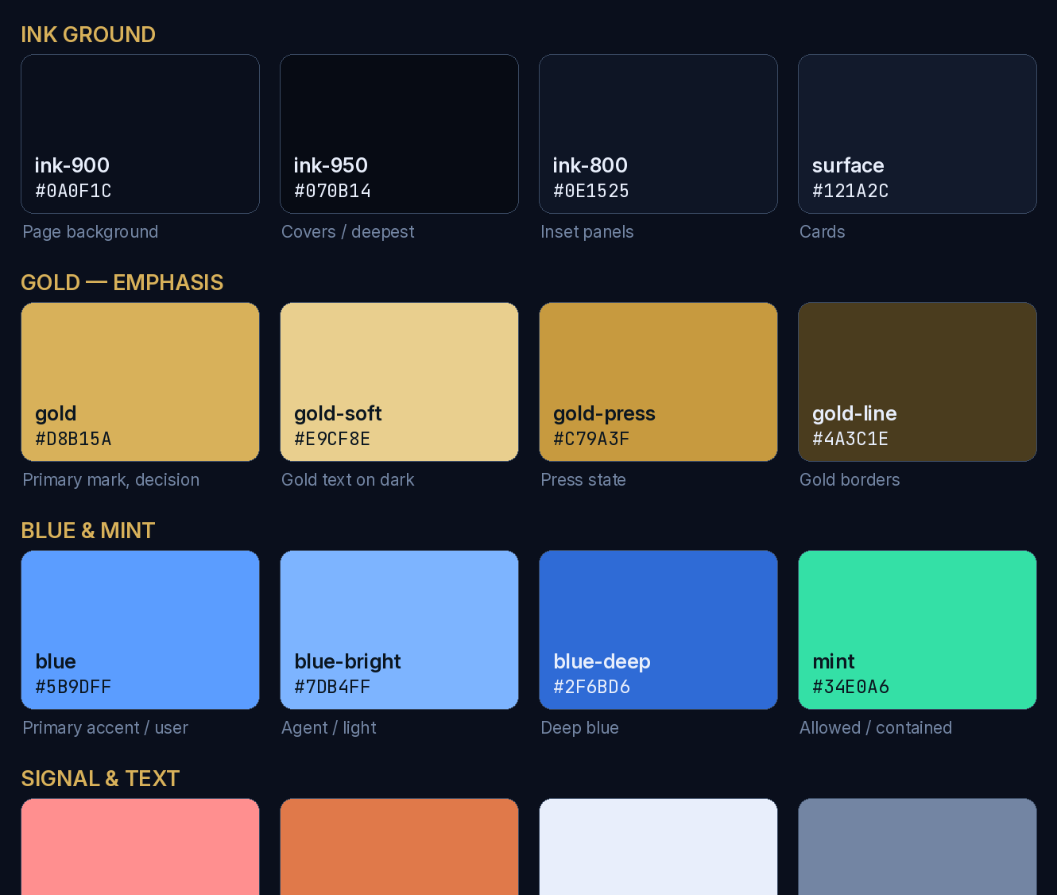
THE PALETTE
Ink ground, gold decision.
Deep ink navy is the foundation. Gold marks the decision and the brand mark. Blue is the user accent, mint means allowed, rose means denied.
THE SEMANTIC CONVENTION
Gold — emphasis and decision
The B5 stage, the authorization decision, the brand mark. Used sparingly; it is the loudest colour in the system.
Blue — the user
Primary accent. The human actor in any diagram.
Blue-bright — the agent
The AI actor. Distinguishes agent from user in the AND-gate.
Mint — allowed and contained
A permitted decision, a contained outcome, a passing check.
Rose — denied and failure
A denial, a breach, a failing check. Never decorative.
Ink — the ground
About 70% of the visual weight. Everything else is an accent on it.
B5 Secure™ Brand Guide · v2.1 · 2026 · B5 SECURE LLC · Published for press & partner use
14

Slide 15
COLOUR — FOUR VALUES V1.0 GOT WRONG
Read the stylesheet, not the old doc.
The v1.0 reference was written before b5.css settled. Four of its values no longer match the deployed site, and one colour in it was never implemented at all.
TOKEN v1.0 REFERENCE LIVE b5.css STATUS
CARD #16243A #121A2C corrected (--surface)
CARD2 #101A2C #0E1525 corrected (--ink-800)
LINE #22324D #1F2C45 corrected (--line)
RED #E86A6E #FF8F8F corrected (--crit)
VIOLET #9B8CFF not present never implemented
The violet question
Why this matters
v1.0 gave violet to “agentic”. The site uses blue-bright. Implement it or drop it.
A deck built from v1.0 will not match the site it links to.
B5 Secure™ Brand Guide · v2.1 · 2026 · B5 SECURE LLC · Published for press & partner use
15

Slide 16
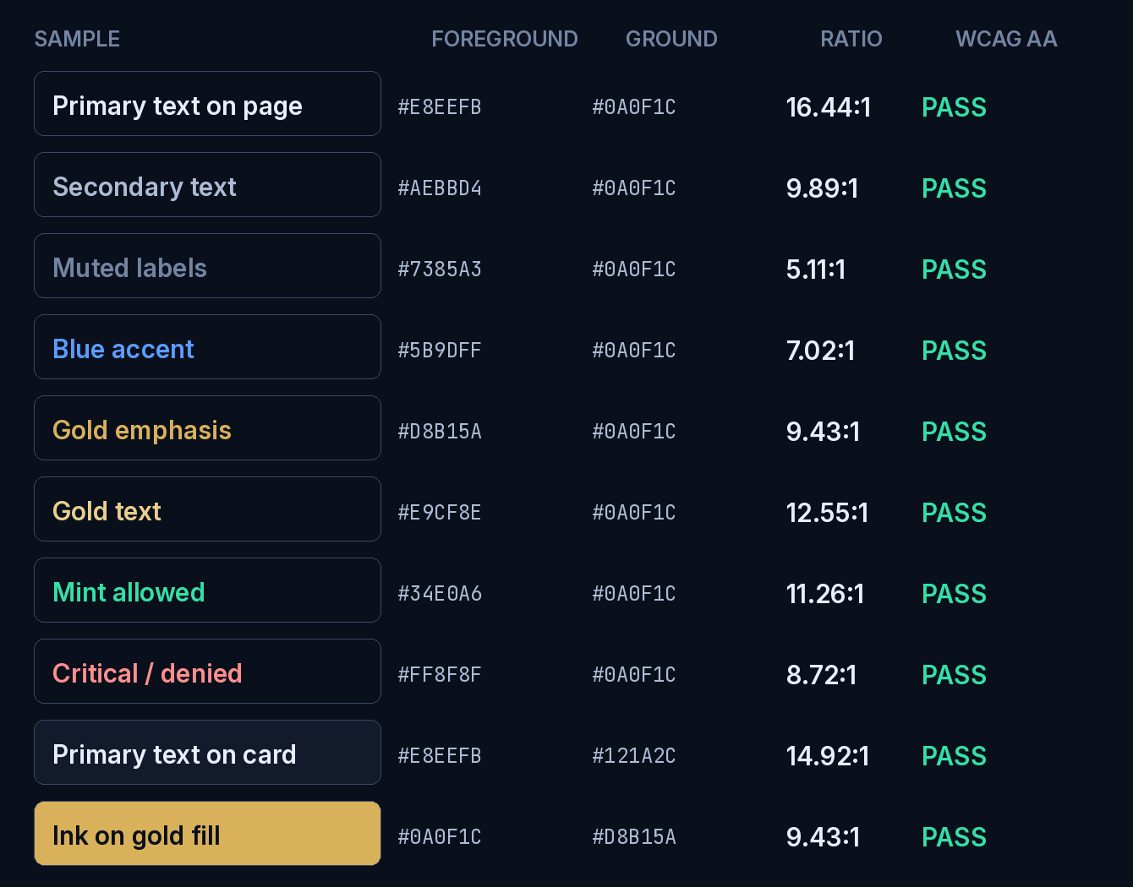
COLOUR — ACCESSIBILITY
Measured, not assumed.
Every pairing below was computed against the WCAG 2.1 relative-luminance formula. Any new pairing must be measured the same way before it ships.
THE RULES
4.5:1 is the floor
Body text and anything below 24px bold needs 4.5:1 against the colour actually behind it.
Measure the composited pixel
Cards, washes and gradients change what is behind the text. Sample the rendered pixel, not the token you intended.
Never sample inside a glyph
It returns exactly 1.00:1, because the text is being compared with itself.
Colour is never the only channel
Allowed and denied must also carry a word or an approved glyph, never colour alone.
B5 Secure™ Brand Guide · v2.1 · 2026 · B5 SECURE LLC · Published for press & partner use
16

Slide 17
04
Typography
Two type systems, one for the browser and one for everything you hand someone.
B5 Secure™ Brand Guide · v2.1 · 2026 · B5 SECURE LLC · Published for press & partner use
17

Slide 18
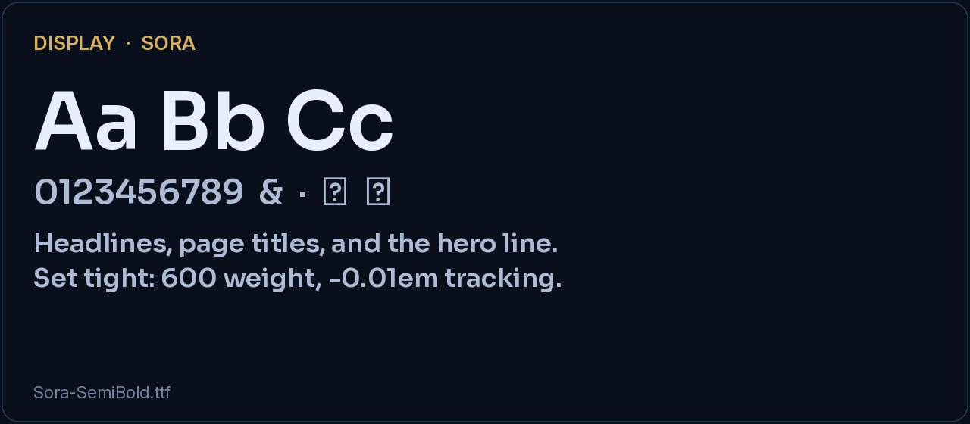
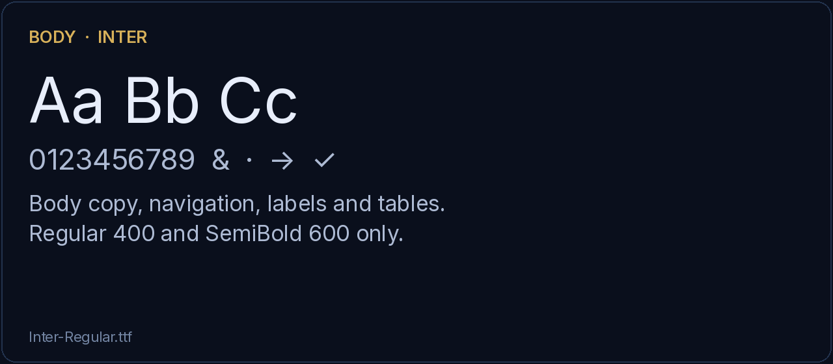
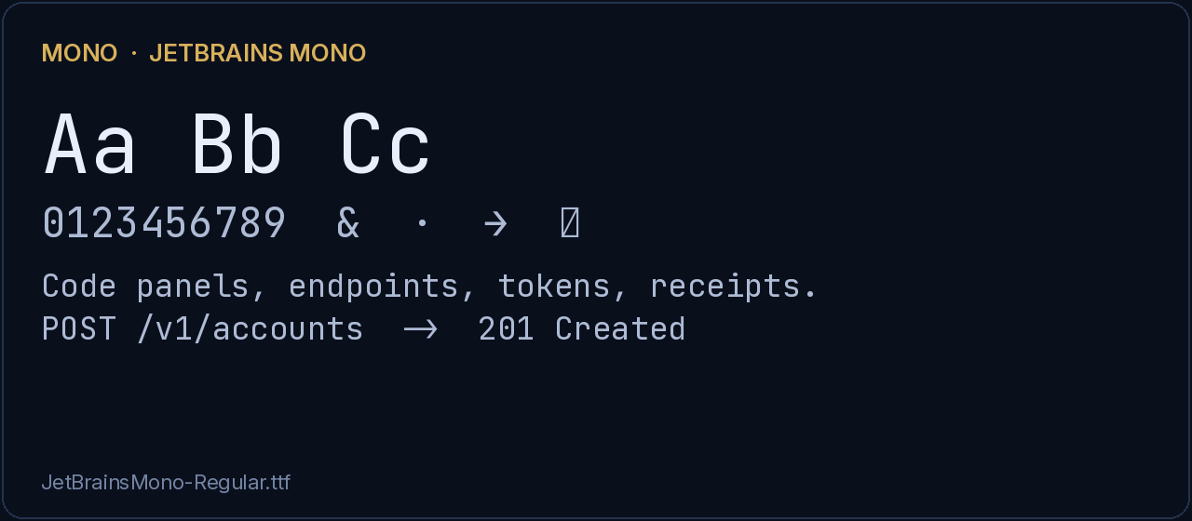
TYPE — THE WEB SYSTEM
Sora, Inter, JetBrains Mono.
All three are self-hosted on b5secure.com. They are the correct faces for anything rendered in a browser — and they replaced the Arial the v1.0 reference specified.
Display — Sora
600 weight. Page titles, hero lines, card headings.
Body — Inter
400 and 600 only. Body copy, navigation, labels, tables.
Mono — JetBrains Mono
400 and 700. Code panels, tokens, signatures, receipts.
B5 Secure™ Brand Guide · v2.1 · 2026 · B5 SECURE LLC · Published for press & partner use
18

Slide 19
TYPE — PRODUCED ASSETS
Arial and Courier New.
A deck or PDF is opened on a machine you do not control, where Sora and Inter are not installed. Produced assets are therefore set in Arial, with Courier New for code.
Display
Arial Bold, 32–44pt
Aa Bb Cc
Section header
Arial Bold, 20–24pt
Body
Arial Regular, 11–14pt
0123456789
Eyebrow
Arial Bold, uppercase, +2.4 tracking, gold
The quick brown fox jumps over the lazy dog.
Mono
Courier New
SECTION LABEL
Caption
Arial Regular, 10pt, txt-3
The v1.0 reference called Arial the primary typeface outright. That is now true only of produced assets — the site itself is Sora and Inter.
B5 Secure™ Brand Guide · v2.1 · 2026 · B5 SECURE LLC · Published for press & partner use
19

Slide 20
05
Components
Cards, stage chips, code panels — and the glyphs that survive a PDF export.
B5 Secure™ Brand Guide · v2.1 · 2026 · B5 SECURE LLC · Published for press & partner use
20

Slide 21
COMPONENTS AND DIAGRAM STYLE
Diagram-first. A slide reads in three seconds.
Show the mechanism as a drawn diagram, not a stack of bullet cards. The card is the base container for everything else.
Card
Stage chip
Rounded rectangle, surface fill, 1px line border, soft drop shadow. Full borders only — never a single-side accent stripe, which reads as filler.
B1–B5 chips joined by › connectors. The decision stage (B5) is accented gold; the rest stay neutral.
Code panel
Outcome card
Mono type on an inset ground. Endpoints, signatures, tokens and decision payloads. Light text on a light ground is the recurring defect — set both.
Mint-surface card for allowed and contained; rose-surface for denied and breach. The word appears in the card, not just the colour.
QA every produced deck visually: export to PDF, rasterize, and look at a contact sheet. The first render usually has a real defect in it.
B5 Secure™ Brand Guide · v2.1 · 2026 · B5 SECURE LLC · Published for press & partner use
21

Slide 22
GLYPHS
These render everywhere. Emoji do not.
Emoji render as broken boxes in LibreOffice and in older PowerPoint. Use the approved glyph set or a drawn shape — never an emoji, in any asset.
APPROVED
✓
✗
→
↓
↑
∩
‹
›
•
NEVER
Emoji of any kind, including lock, warning and explosion glyphs — they break on export.
A literal bullet character typed into a list — use the list’s own bullet, or it doubles.
Colour alone to carry allowed or denied — pair it with ✓ or ✗ and the word.
B5 Secure™ Brand Guide · v2.1 · 2026 · B5 SECURE LLC · Published for press & partner use
22

Slide 23
06
Voice
How B5 Secure sounds, and the five sentences it must never say.
B5 Secure™ Brand Guide · v2.1 · 2026 · B5 SECURE LLC · Published for press & partner use
23

Slide 24
VOICE AND TONE
Authoritative, precise, honest.
We state; we do not hedge. We use exact terms, name the limits, and cite the source.
Authoritative
Precise
Honest
Concise
Declarative, calm, confident. We state. We do not hedge.
Authentication is not authorization. Signing is not encryption.
Name the limit. Mark modelled ROI as modelled. Cite the source.
Lead with the answer. Cut filler. Let the diagram carry the load.
“Identity proves who. It doesn’t decide what. B5 authorizes the data element — fail-closed, for users and agents.”
B5 Secure™ Brand Guide · v2.1 · 2026 · B5 SECURE LLC · Published for press & partner use
24

Slide 25
MESSAGING
Say this. Not that.
WE SAY
WE AVOID
Identity proves who; it doesn’t decide what.
HMAC authenticates — TLS encrypts.
Signed requests beat bearer tokens, the common default.
Authorization is the product; signing is one stage.
Fail-closed: absence of a permit is a denial.
The same contract for users and AI agents.
“B5 is HMAC.” It is an authorization layer.
“HMAC encrypts the request.” It does not.
“Bearer tokens are simply wrong.” They are the default.
“We stop every breach.” We contain and gate.
“Per record” — retired in favour of per data element.
Any statistic without a named, dated source.
B5 Secure™ Brand Guide · v2.1 · 2026 · B5 SECURE LLC · Published for press & partner use
25

Slide 26
CLAIMS AND SOURCING
The evidence bar is higher, not lower.
B5 has no production customers yet. That makes every number either sourced, modelled-and-labelled, or absent.
STATEABLE
NOT STATEABLE
Mechanisms the specification defines, described as specified.
Standards by number: RFC 9421, ML-DSA, OCSF, SARIF.
Third-party statistics with publisher, study and year.
Modelled ROI, explicitly labelled modelled.
Design-partner status, where a badge says exactly that.
Customer names, logos or counts — there are none in production.
Uptime, latency or throughput without a measurement window.
Breach-prevention rates or security guarantees.
Certification or audit status not yet held.
Any comparison to a named competitor’s capability.
B5 Secure™ Brand Guide · v2.1 · 2026 · B5 SECURE LLC · Published for press & partner use
26

Slide 27
THE ONE STATISTIC
How a sourced number looks.
This is the only external statistic approved for standing use. It is the template for any future one: claim, publisher, study, year.
“97% of AI-related breaches involved missing or improper access controls.”
IBM Cost of a Data Breach Report 2025, research conducted by Ponemon Institute.
Cite it in full on first use in every asset. A footnote reading “IBM 2025” is not a citation.
Why this one earns its place
What would disqualify a statistic
It describes the gap B5 closes — access control, not detection — and it comes from a named annual study with a stated methodology.
A vendor blog, an undated figure, a number quoted from a deck rather than the source, or a statistic about a market rather than a mechanism.
B5 Secure™ Brand Guide · v2.1 · 2026 · B5 SECURE LLC · Published for press & partner use
27

Slide 28
07
Assets
Where everything lives, and what is new in this edition.
B5 Secure™ Brand Guide · v2.1 · 2026 · B5 SECURE LLC · Published for press & partner use
28

Slide 29
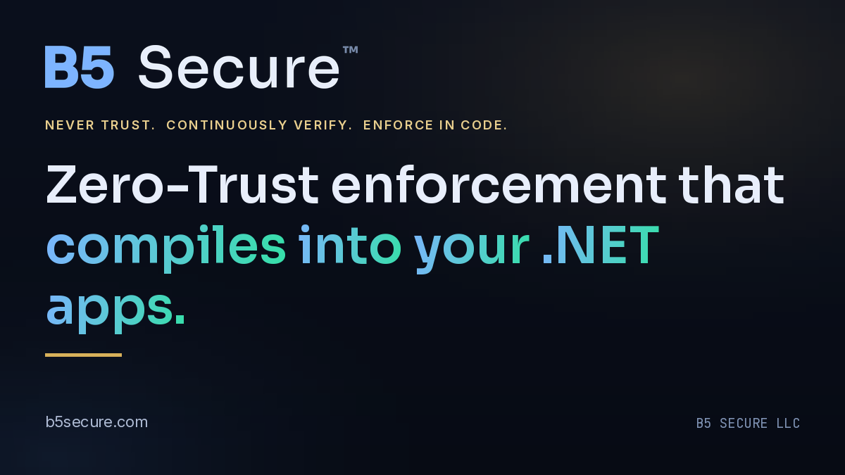
SOCIAL AND OPENGRAPH
The share card is a brand surface.
A link posted to LinkedIn or X renders the OpenGraph card, not the page. It is often the first brand impression a buyer gets.
New default
b5secure-og-1200x675.png
Size
1200 × 675 px (16:9)
Set in
Yoast SEO → Social → Default image
Ground
ink-900 to ink-950
Type
Sora SemiBold + gradient run
Safe area
64px on all four edges
Also available
1200×630, 1584×396, 1500×500
1200 × 675 is 16:9, which X and LinkedIn prefer. Facebook’s canonical ratio is 1.91:1, so it may trim a few pixels top and bottom — which is why nothing sits within 64px of an edge.
B5 Secure™ Brand Guide · v2.1 · 2026 · B5 SECURE LLC · Published for press & partner use
29

Slide 30
ASSET INDEX
Everything, with its real path.
All paths are relative to https://b5secure.com/wp-content/uploads/b5/. Verified present in the deployed site.
BRAND AND MEDIA
MARKS, CSS AND CHROME
media/
b5-mark.svg mark only
b5-lockup-horizontal.svg lockup
b5-lockup-reverse.svg reverse lockup
b5secure-og-1200x675.png OG default (new)
b5-og-1200x630.png legacy OG card
b5-linkedin-1584x396.png
b5-x-1500x500.png
B5-Secure-Brand-Guide-v2.pdf this doc (new)
B5-Secure-Brand-Guide.pdf v1.0, retained
B5-Secure-Media-Kit.pdf
b5-authz-flow.svg / .png
b5-pipeline.svg / .png
b5-mark-gold.svg b5-mark-light.svg
b5-mark-dark.svg b5-favicon.svg
b5-logo.svg b5-logo-reverse.svg
b5-secure-wordmark-{dark,light,mono}.svg
b5.css tokens + components
b5.js
B5-Brand-Showcase.html
The live header, dark theme and cache-buster
are Code Snippets rows 7, 6 and 10 -- not the
mu-plugin. b5.css cache-busts on its own
file mtime, so a re-upload is enough.
B5 Secure™ Brand Guide · v2.1 · 2026 · B5 SECURE LLC · Published for press & partner use
30

Slide 31
DRIFT REGISTER
What v1.0 got wrong, and what is still open.
A brand guide that hides its own errors cannot be trusted as a source. These were found by measuring the live site against the v1.0 reference.
CORRECTED IN v2.0
Four palette values
CARD, CARD2, LINE and RED all differed from the live b5.css.
“Arial is the primary typeface”
True of produced assets only. The site is Sora and Inter.
OPEN — NEEDS AN OWNER DECISION, NOT A DESIGN DECISION
“per-record” on b5secure.com
57 instances in page copy, plus the sitewide ribbon line.
Lockup files are blue
The guide says gold is primary; the lockup SVGs are #2f6bd6 / #7db4ff.
VIOLET #9B8CFF
Specified for “agentic” in v1.0, never implemented. Implement or drop.
B5 Secure™ Brand Guide · v2.1 · 2026 · B5 SECURE LLC · Published for press & partner use
31

Slide 32
QUICK REFERENCE
One page to keep open.
COLOUR TOKENS
TYPE AND GLYPHS
THE FIVE THINGS
ink-900 #0A0F1C
ink-950 #070B14
ink-800 #0E1525
surface #121A2C
line #1F2C45
gold #D8B15A
gold-soft #E9CF8E
blue #5B9DFF
blue-bright #7DB4FF
mint #34E0A6
crit #FF8F8F
txt #E8EEFB
txt-2 #AEBBD4
txt-3 #7385A3
Web display: Sora 600
Web body: Inter 400 / 600
Web mono: JetBrains Mono
Produced: Arial + Courier New
Eyebrow: bold, uppercase, +2.4 tracking, gold
Glyphs: ✓ ✗ → ↓ ↑ ∩ ‹ › • — never emoji
Data element, never per record
Authorization is the product; signing is one stage
HMAC authenticates — TLS encrypts
Gold mark on dark is primary
Every number sourced, modelled-and-labelled, or absent
B5 Secure™ Brand Guide · v2.1 · 2026 · B5 SECURE LLC · Published for press & partner use
32

Slide 33
Zero-Trust enforcement that compiles into your .NET apps.
© 2021–2026 B5 SECURE LLC. B5 Secure™ is a trademark of B5 SECURE LLC · PO Box 1410, Menlo Park, CA 94026-1410.
California registration #202114811376. Published for press & partner use.

